Slide 1
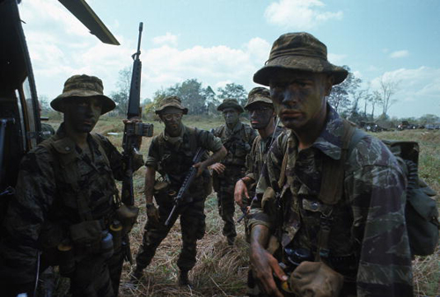
Origins of the Vietnam War

Slide 2
Terms and People
Ho Chi Minh − a Vietnamese leader who demanded Vietnam’s independence from France
domino theory − the idea that if a nation fell to communism, its closest neighbors would follow
Dien Bien Phu − a French military base besieged by Vietminh troops until the French surrendered

Slide 3
Terms and People (continued)
Southeast Asia Treaty Organization (SEATO) − defensive alliance aimed at preventing communist aggression in Asia
Vietcong − South Vietnamese guerrilla fighters supported by communists in North Vietnam
Gulf of Tonkin Resolution − 1964 congressional resolution that authorized President Johnson to commit American troops to South Vietnam and fight a war against North Vietnam

Slide 4
The United States became involved in Vietnam for several reasons.
The United States wanted France as an ally in the Cold War.
The United States also wanted to support any government that was fighting communism.

Slide 5
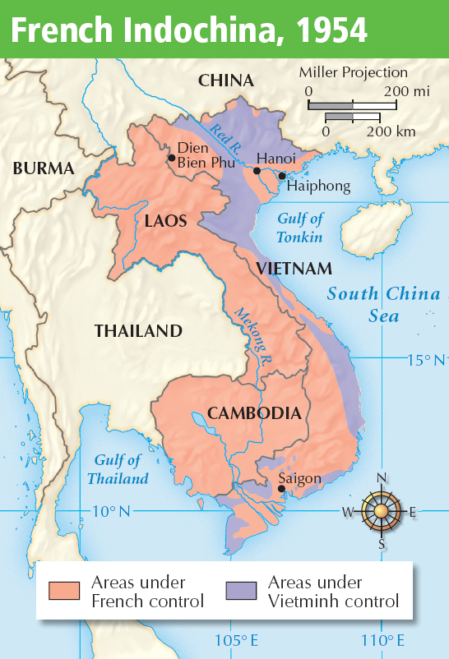
French colonial governments had ruled most of Indochina since the 1800s.
The French exploited Indochina’s wealth by owning plantations, claiming mineral rights, and imposing high taxes.
Notes:
5

Slide 6
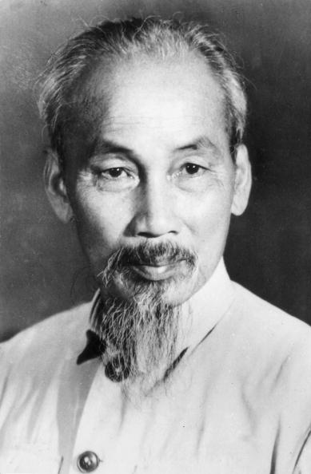
Vietnamese leader Ho Chi Minh worked to free Vietnam from colonial rule.
Unable to get support from western nations, he embraced communism and received support from Soviet communists.

Slide 7
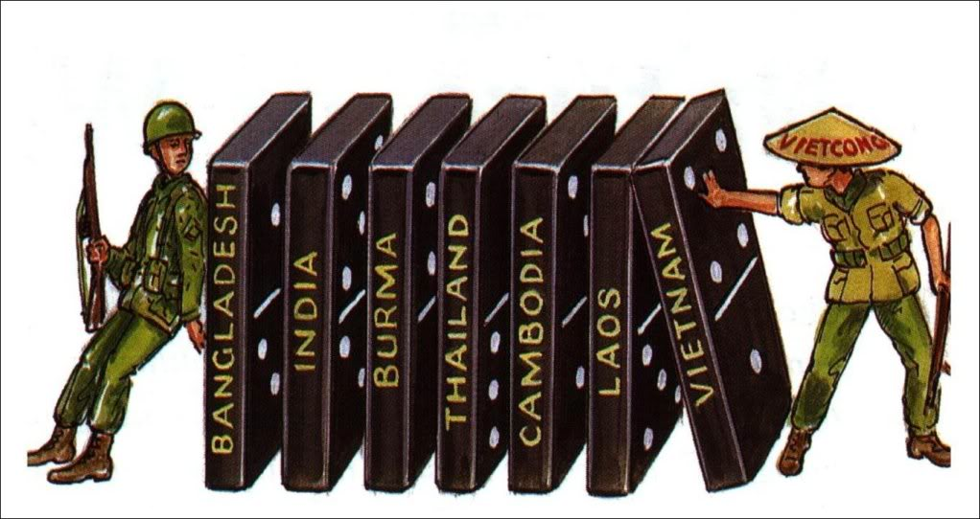
In 1954, President Eisenhower introduced the domino theory, which said that if Vietnam became communist, its closest neighbors would follow.
If communism spread throughout the region, Eisenhower feared, it could threaten Japan, the Philippines, and Australia.
Notes:
7

Slide 8
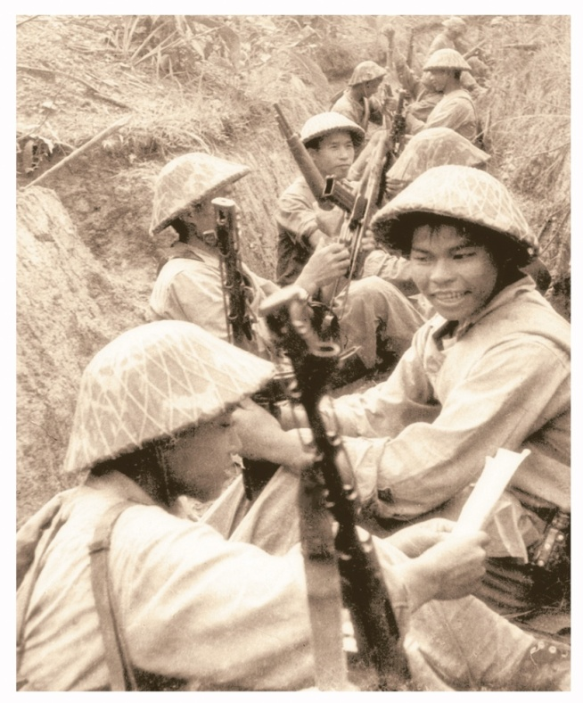
Despite U.S. financial support, the French were defeated by Vietminh forces at Dien Bien Phu.
The Vietminh hammered at French forces and laid siege to the base for 55 days.
After suffering more than 15,000 casualties, the French surrendered on May 7, 1954.
In the peace accord that followed, Cambodia, Laos, and Vietnam gained independence from France.

Slide 9
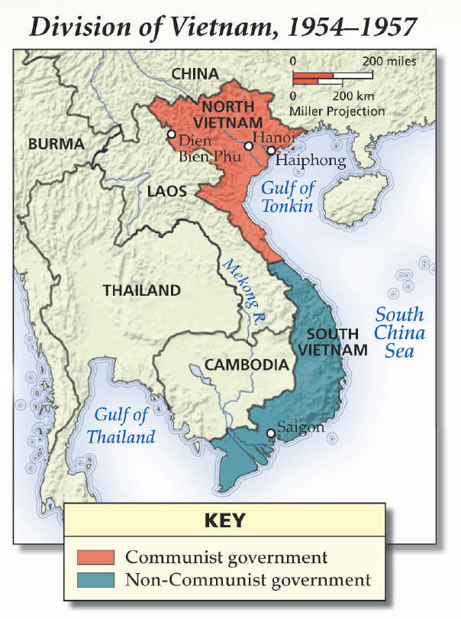
Vietnam was divided into two countries.
Ho Chi Minh’s communist government ruled North Vietnam.
An anticommunist government, supported by the United States, ruled South Vietnam.

Slide 10
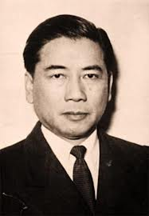
South Vietnam’s president, Ngo Dinh Diem, was not a popular leader.
A group of rebel guerilla fighters formed the National Liberation Front (NLF) to oppose the Diem government and unite Vietnam under communist rule.

Slide 11
The United States supported South Vietnam in several ways.
formed the Southeast Asia Treaty Organization, which opposed communism gave economic and military aid sent Special Forces soldiers to “advise” South Vietnamese troops
Notes:
11

Slide 12
In 1961, President Kennedy sent Special Forces troops to help fight the Vietcong, the guerilla fighters of the National Liberation Front.
The Diem government remained unpopular, however, and the Kennedy administration worked behind the scenes to remove Diem from power.

Slide 13
In 1964, President Johnson faced his first crisis
in Vietnam.
He then asked Congress to authorize the use of force to defend U.S. troops.
North Vietnam attacked an American destroyer in the Gulf of Tonkin.
Johnson ordered an airstrike against North Vietnam.
In response, Congress passed the Gulf of Tonkin Resolution.

Slide 14
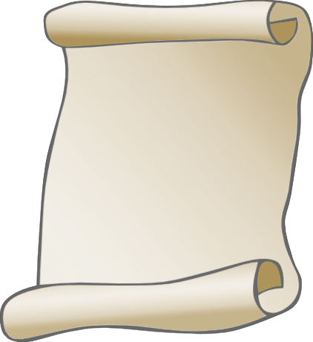
The Gulf of Tonkin Resolution gave Johnson tremendous war powers.
It allowed him to commit U.S. troops to South Vietnam.
It enabled him to fight a war against North Vietnam without asking Congress for a declaration of war.
Notes:
14

